Slide 1
Conductors at RF and Transmission Lines
Week 1

Slide 2
At DC
Resistance = Length / (Conductivity * Cross Sectional Area)
Resistance = Length * Resistivity / CSA
At DC, whole conductor is used to carry the current

Slide 3
At AC
Resistance increases with frequency because of skin effect (inductance)
XL = jwL where w = 2pi f ao XL = j 2 pi fL
RF current flow migrate to the outer edge of the conductor to flow along path with least resistance

Slide 4
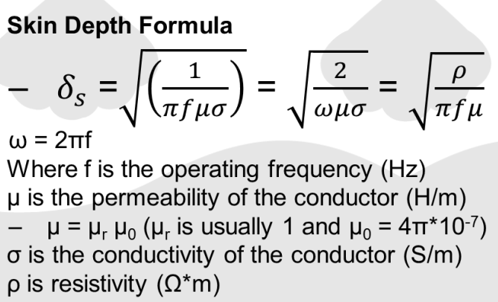
Skin Depth Formula

Slide 5
Common Transmission Lines
TV and RF cables
Microstrip
Twisted Pair

Slide 6
Size of Transmission Lines
Length of cable >0.1 lambda (1/10 of wavelength of transmitted signal)
If not:
Reflection
Radiation

Slide 7
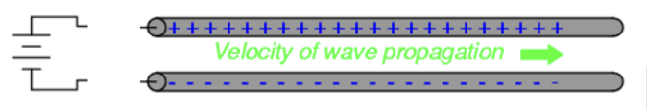
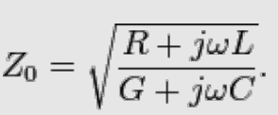
Characteristic Impedance
A transmission line of infinite length, what happens when a battery is connected?

Slide 8
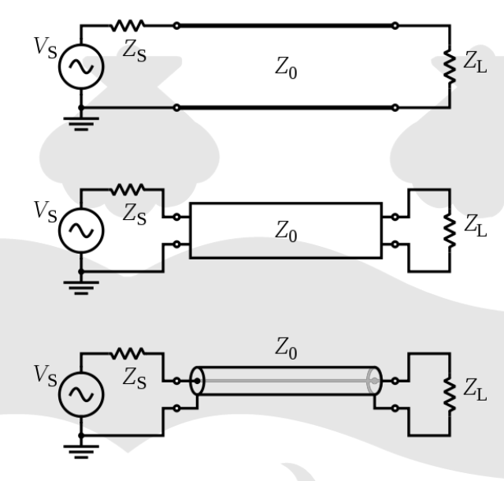
Transmission Line Models
Zs = input impedance
Zo = characteristic impedance
ZL = load impedance

Slide 9
